Slide 1
Molecular Biology Biol 480
Lecture 7 January 25, 2019

Slide 2
Announcements/Assignments
Exam 1 ---Monday Feb. 4th.
Do you find the lecture summary “forms” helpful?

Slide 3
Where were we…
DNA topology---What does this refer to?
DNA is a helical molecule, with intertwined strands.
The number of times the strands turn about each other (helical turns) is also known as the DNA molecule’s TWIST. In the model of B-DNA, DNA has 1helical turn or twist/10.4 base pairs.

Slide 4
DNA topology---What does this refer to?
In addition to a DNA molecule’s TWIST, the entire double helix become intertwined with itself forming supercoils. We describe these added turns of the DNA molecule as WRITHE---and the turns of the whole helix as supercoils.

Slide 5
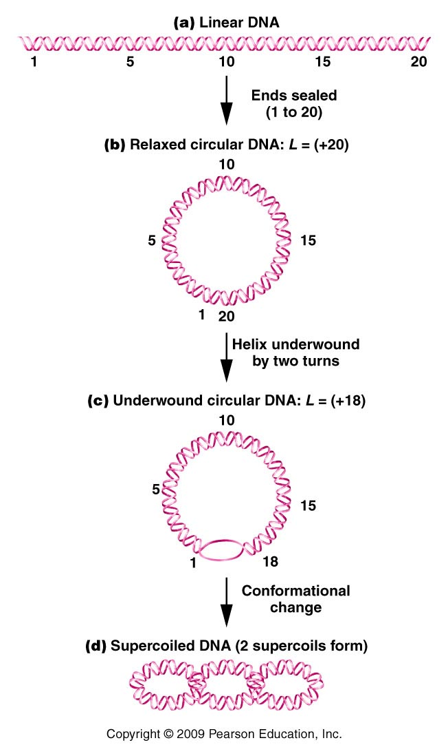
Figure 12.4
Notes:
Figure 12-4 Depictions of the transformations leading to the supercoiling of circular DNA. L equals the linking number.

Slide 7
Who cares? ;)
We took advantage of differences in supercoiling in the larger E. coli chromosome and the smaller pGLO plasmid to separate the two, and recover the plasmid
The stress imposed on DNA molecules through twist and writhe actually create potential energy and help open the helix for mechanisms like transcription and translation.

Slide 8
DNA molecules are constantly experiencing changes in twist due to transcription and replication (when the strands separate)
Topoismerases were discovered to facilitate and relieve stress in DNA molecules.
Without the proper activity of topoisimerases, cellular DNA breaks and cells die.
Cancer killing drugs have been developed based on this phenomenon!

Slide 9
The new video linked to the website is excellent!
Listen and process the information that further explains what I have said. You need not worry about left or right helices, or positive and negative supercoils!
Keep in mind eukaryotic chromosomes are linear, but have many anchor points which give them similar properties to circular DNA.
Any math questions will be simple!

Slide 10
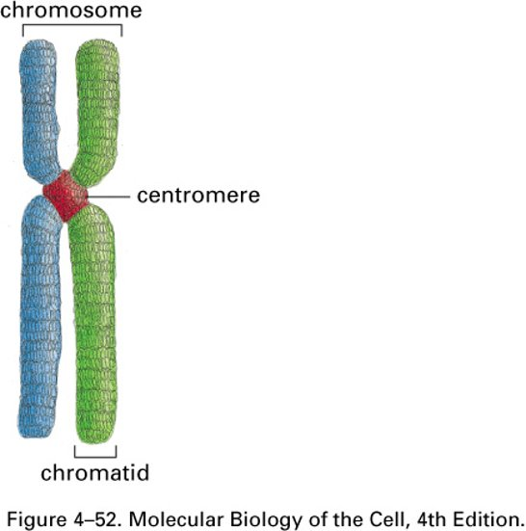
Eukaryotic chromosomes
DNA associates with Histone proteins to form chromosomes. Loosely analogous to spooling of thread and the stacking of spools, and the looping of stacked spools!

Slide 11
Dynamic structure—DNA organization Chapter 12 in your text

Slide 12
Nucleosomes

Slide 13
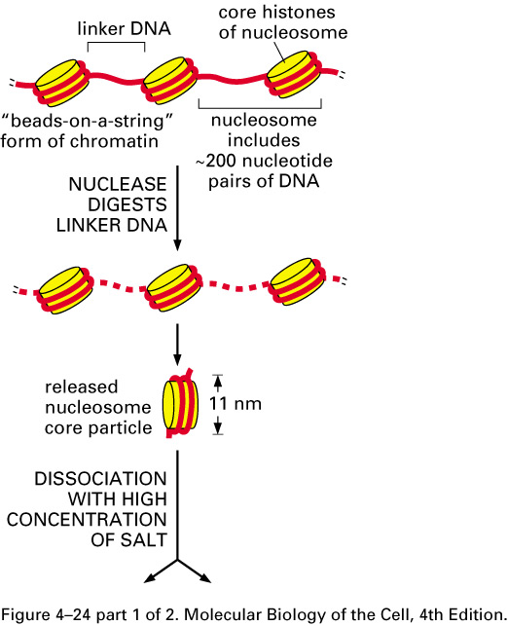
Specific enzymes can access the linker DNA and cut chromatin into individual nucleosomes.
If you digest away the histones you are left with DNA ~200 bp in length. (DNA that was wrapped twice around and octet of Histones, and the linker section of DNA

Slide 14
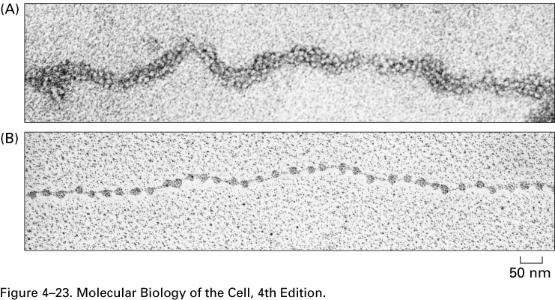

Slide 15
During apoptosis, cellular DNA is fragmented in this way. If you purify DNA from apoptotic cells you find it has been digested in linker regions.

Slide 17
Histones
5 types of histones have been identified.
All are positively charged—why is this important?
What makes a protein positively charged?

Slide 18
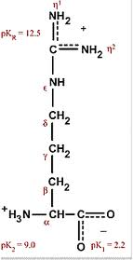
Lots of Lysine and arginine (basic/pos chared ) amino acids in the protein
Lysine
Arginine

Slide 19
Amino Acids (1- and 3-letter codes)

Slide 20
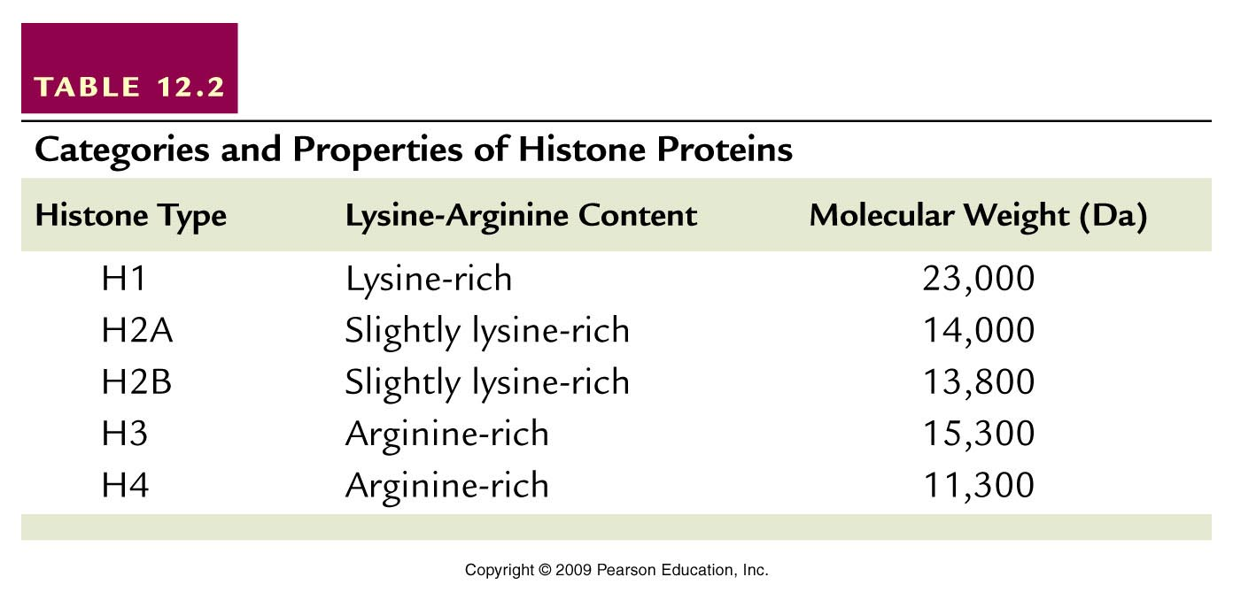
Table 12.2
Notes:
Table 12-2 Categories and Properties of Histone Proteins

Slide 21
4 different types of histone proteins are similar in sequence and folded shape. They interact with each other in the core of the nucleosome.

Slide 22
Then N-terminus of each histone protein remains relatively free from the interacting cluster. Small regions of the C-terminus also remain free. These are known as histone “tails”

Slide 23
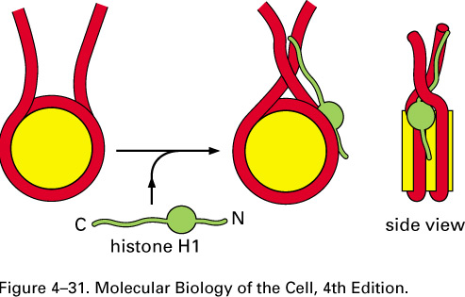
Histone H1 associates with the linker region between nucleosomes.

Slide 24
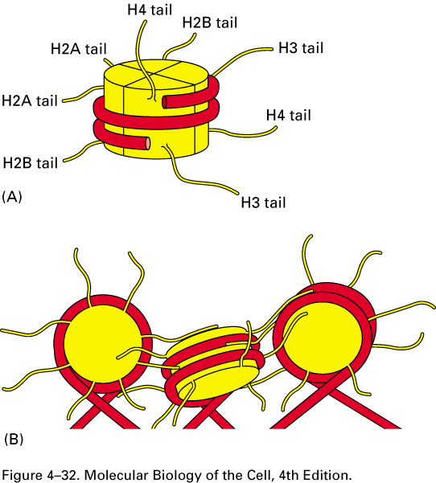
The histone tails are really responsible for the associations of nucleosomes with other nucleosomes.

Slide 25
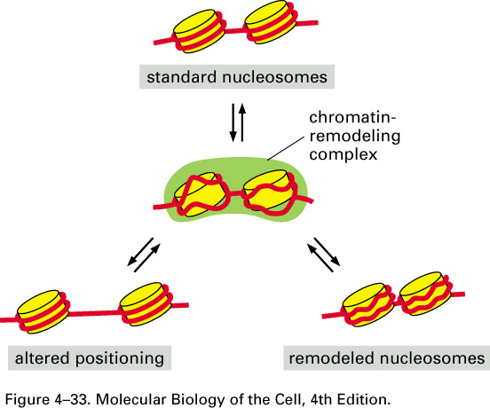
The associations are dynamic—changing the level of condensation/compaction of the DNA

Slide 26
How does it work?
The histone tails can be chemically modified in a number of ways:
Acetylation
Methylation
Phosphorylation
Specific amino acids of the histone proteins can be modified in each way.

Slide 27
Note the “Ks” and “Rs” indicating specific amino acids in histones

Slide 28
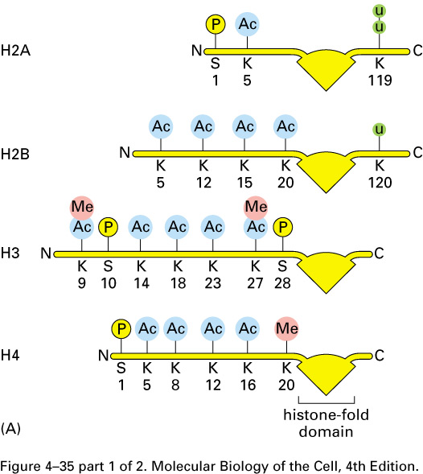

Slide 29
Although there is not an absolute understanding of the outcome of every modification, there is a general trend to the “meaning” of each type of modification, depending where it occurs.
In general acetylation seems to interfere with histone-DNA electrostatic interaction and removes nucleosomes from a region of DNA.

Slide 30
In general, fewer histones, means more open, more loosely folded chromatin and more access for proteins that facilitate transcription.

Slide 31
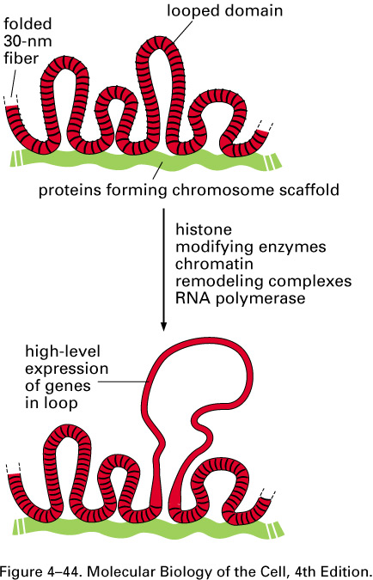

Slide 32
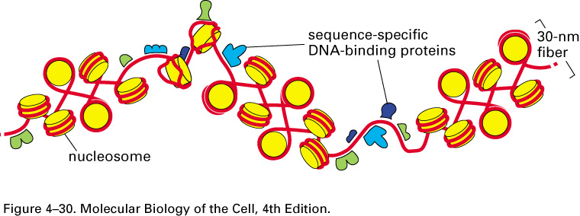
Transcription, the first step in gene expression, requires many proteins (including RNA polymerase) bind directly to the DNA. These proteins cannot do this if the DNA is entirely composed of nucleosomes or stacks of nucleosomes.

Slide 33
A major field of molecular genetics focuses on how histone and DNA modifications affect chromatin assembly and “remodeling” and ultimately gene expression.
This is a major aspect of epigenetics. Factors that change gene expression, but which have nothing to do with DNA sequence.

Slide 34
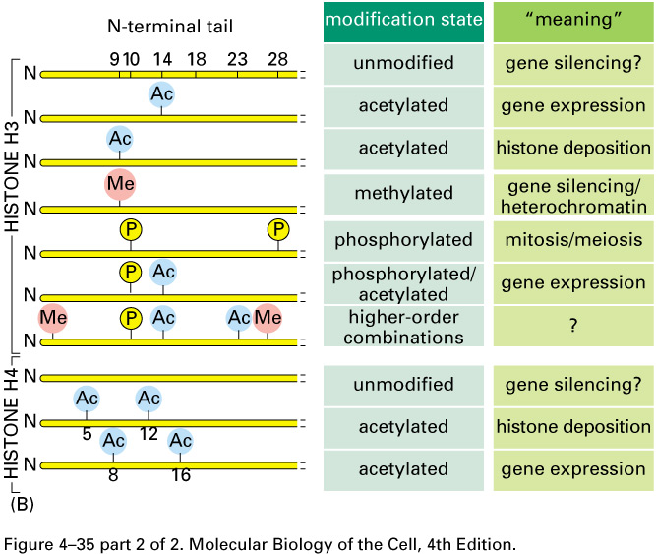

Slide 35
Certain regions of our chromosomes are always very tightly compacted/condensed and rarely, if ever, “remodeled”. Not surprising, these areas have few actively transcribed genes.
These areas are known as heterochromatin.
(Chromatin that is not permanently compacted and capable of being remodeled and having active genes is called euchromatin).

Slide 36
Centromeres and telomeres are largely heterochromatin. There are really no active genes near centromeres or telomeres.
We can see experimentally that the same gene, in 2 different locations on a chromosome, has different potential for transcription.

Slide 37
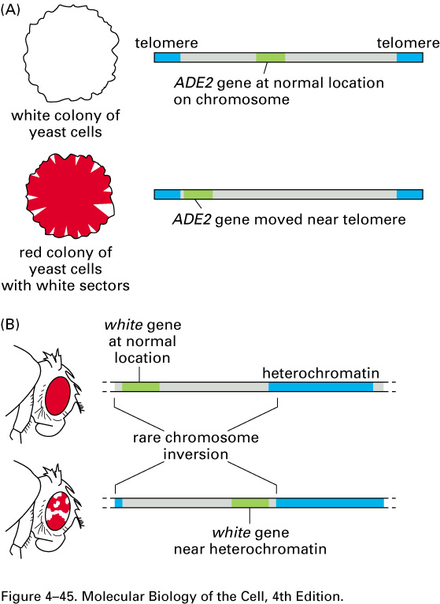

Slide 38
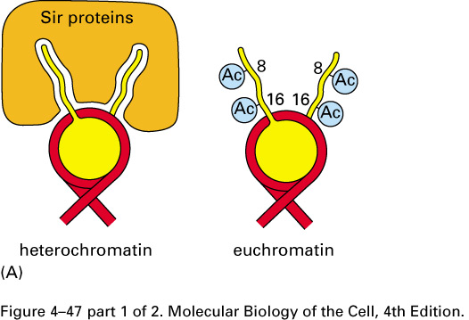
Specific proteins play a role in maintaining heterochromatin---for example, Sir proteins block chromatin loosening modifications of histone tails. Keep telomeres tightly coiled/condensed.

Slide 39
Some chromosomes are entirely or nearly entirely heterochromatic.
Y chromosome in male mammals (contains very few actively transcribed genes)
One X-chromosome in each cell of female mammals ---permanently inactivated to provide gene dosage compensation. Called a Barr body.
(chapter 7)

Slide 40
These 2 general types of DNA were first recognized when chromosomes were stained with a compound called Giemsa.
Until the 1970s techniques to stain chromosomes allowed one to see chromosomes, but showed more or less uniform staining of each chromosome in a cell

Slide 41
Methods were developed to treat the chromosomes with chemicals and or heat to allow differential uptake of giemsa stain.
These methods provided visible bands/stripes along the length of chromosomes, allowing identification of individual chromosomes.

Slide 42
Figures 12-11, 12, 13
Variations of staining methods (look these up)
C-banding
G-banding
R-banding
Q-banding

Slide 43
C-banding

Slide 44
G-banding with schematic
ajdlfjlf

Slide 45
R-banding next to G-banding

Slide 46
In all banding techniques, where bands appear, there are differences in packing of the DNA.
Now bands are the primary way cytogenetics identify parts of chromosomes.

